Slide 1
Name : Rupali Vijay Raut Internship : Ethical Hacking Task : 3 Email: rupa1613037@gmail.com

Slide 2
Report on task 3:

Slide 3
Title: Cross Site Scripting
Domain: Vulnweb.com
Subdomain: testasp.vulnweb.com
Steps :
Step 1: Visit http://testasp.vulnweb.com/
Step 2: On the top menu you will find a search option.
Step 3: Click on it and you will be prompted with the Search box.
Step 4: You can intercept the request in Burp Suite
Step 5: Now you can find different payloads for XSS.
Step 6: Send the request to the intruder and paste all the payloads.
Step 7: Try to find a successful payload for XSS.

Slide 4
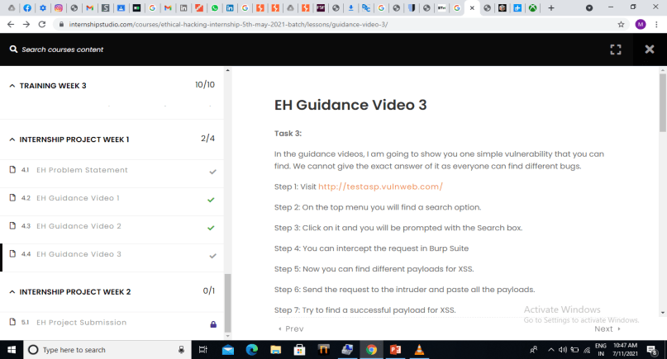
Step 1: Visit http://testasp.vulnweb.com/

Slide 5
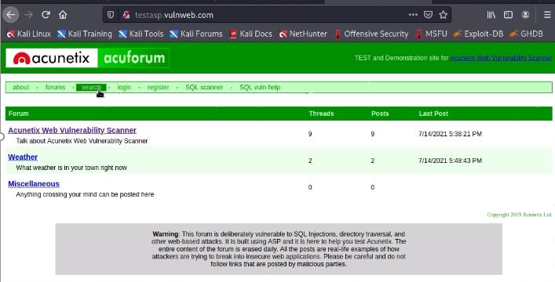
Step 2: On the top menu you will find a search option.

Slide 6
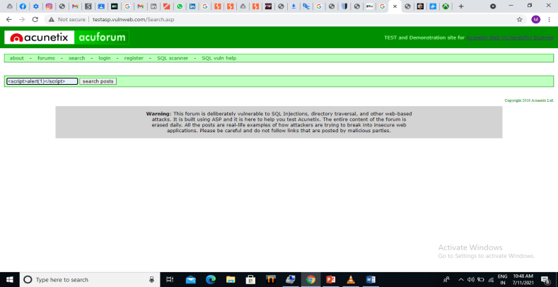
Step 3: Click on it and you will be prompted with the Search box.

Slide 7
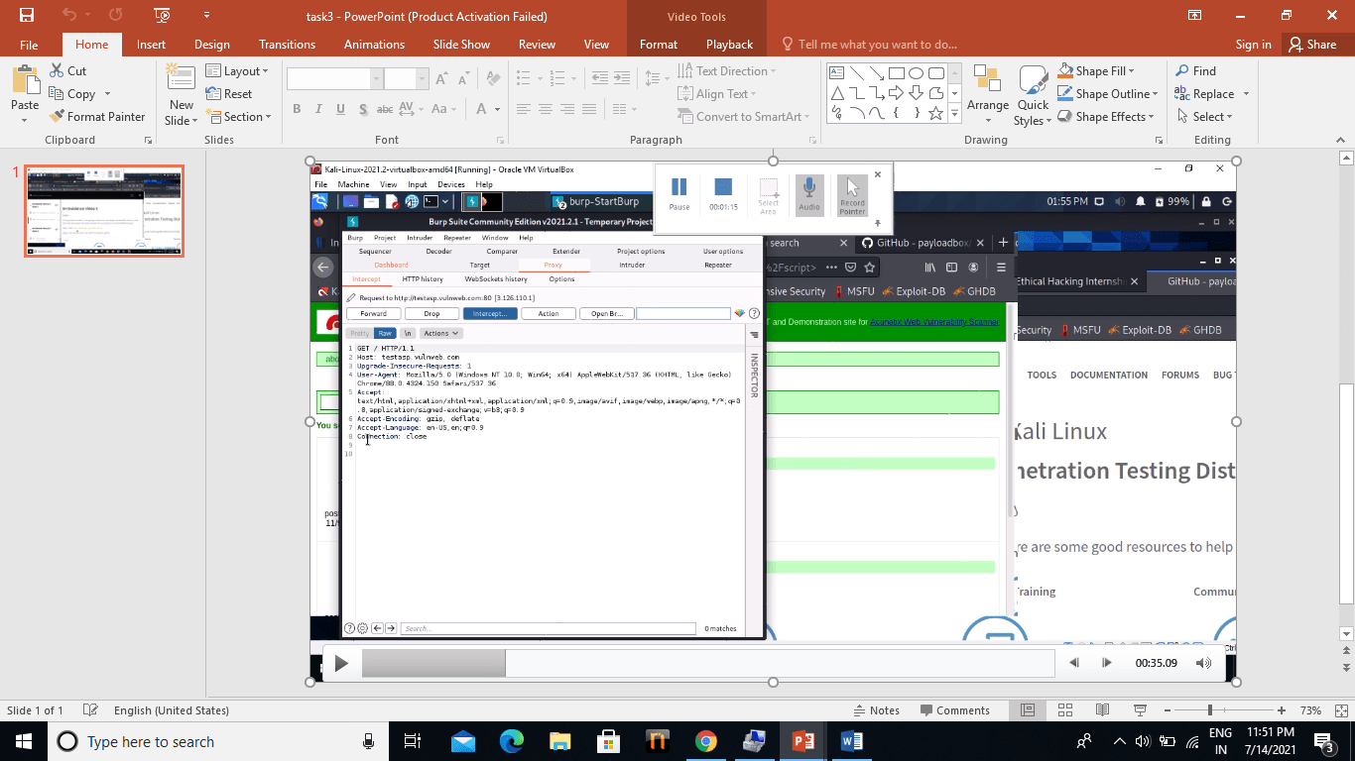
Step 4: You can intercept the request in Burp Suite

Slide 8
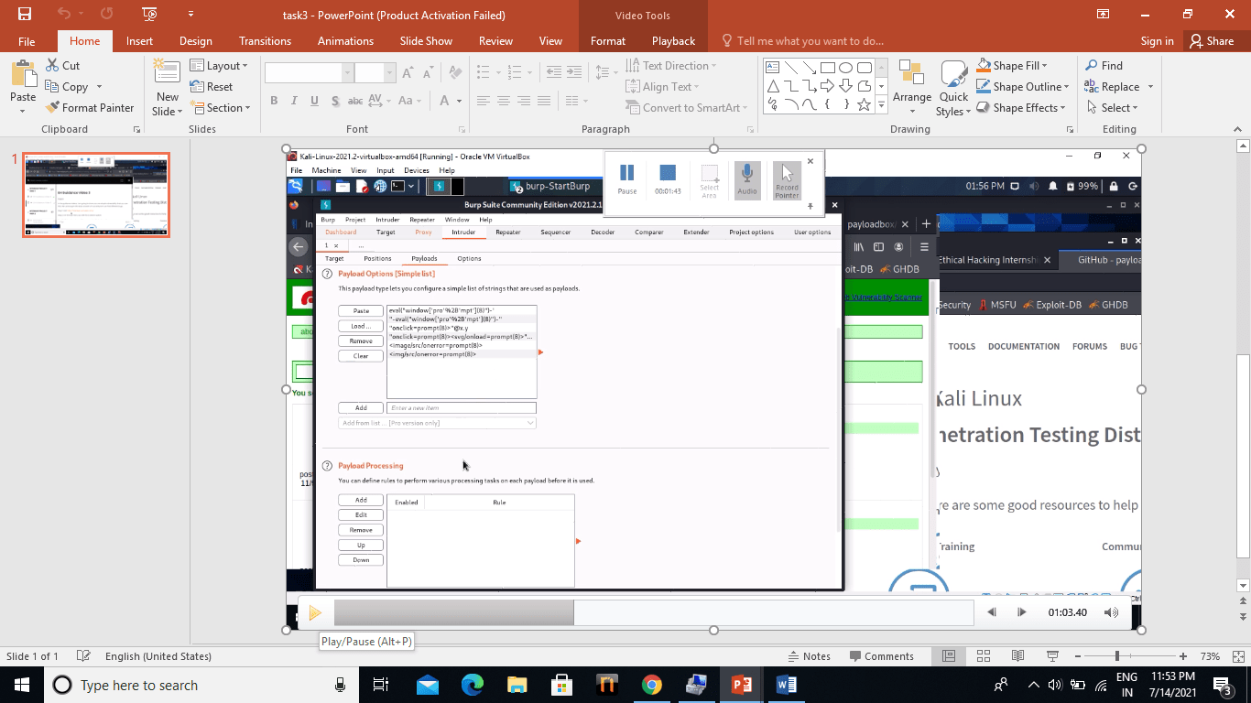
Step 5: Now you can find different payloads for XSS.

Slide 9
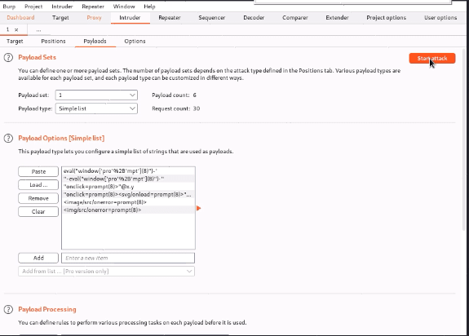
Step 6: Try to find a successful payload for XSS.

Slide 10
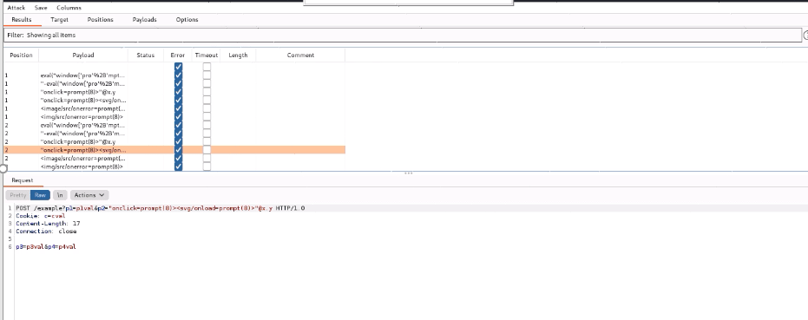

Slide 11
Impact:cross site scripting can leads to stealing of your user data and it can be harmful for your website/company Mitigation: if you want to prevent your website to be vulnerable of cross site scripting then you can just enable noscript on browser.

Slide 12
POC including screen recording is included in report which is attached below:

Slide 13
Here, I completed task3 successfully….

